Slide 1
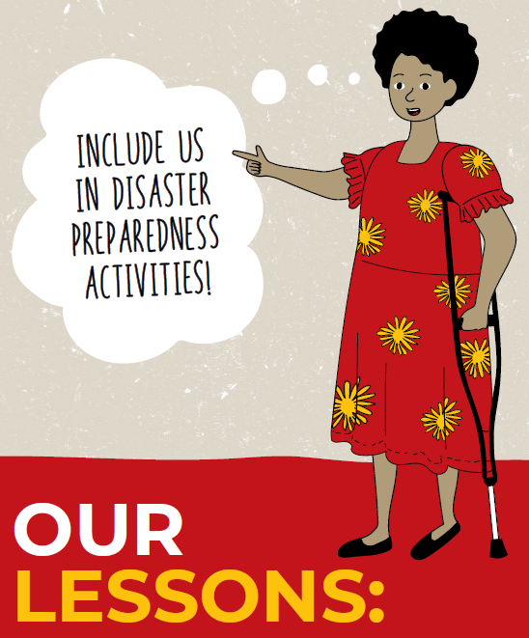
Findings from:
Consultation with People with Disabilities
in the Asia and Pacific regions
on Disasters and Disaster Risk Reduction
Funded by:

Slide 2
Welcome
Please introduce yourself in the chat box
Name
Organisation you are from
Country you are from

Slide 3
Housekeeping and accessibility tips
Ask a question
Captioning and language interpretation are available
Please keep your microphone muted and camera turned off
If you have a question: raise your hand/type in the chat box
If you need assistance: message Laura in the chat box

Slide 4
Acknowledgement of Country

Slide 5
Seta Macanawai CEO of the Pacific Disability Forum

Slide 6
 | Agenda
12.00 | Welcome, introductions and accessibility
12.05 | Keynote address by Australia’s Department of Foreign Affairs and Trade
12.10 | Key findings from the consultation
12:15 | Speakers who participated in the consultation share their stories
12.45 | Question time
12.55 | Call to Action and Close

Slide 7
Keynote address by Australia’s Department of Foreign Affairs and Trade

Slide 8
Key Findings from the consultation

Slide 9
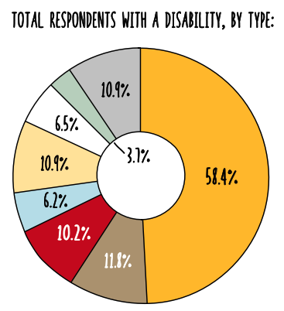
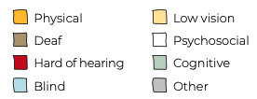
Consultation participants
506 people from across Asia and the Pacific completed an online survey
An additional 80 people participated in virtual focus group discussions and key informant interviews in the South and East Asia regions.
84 people participated in face-to-face focus group discussions and key informant interviews in five Pacific Islands Countries.

Slide 10
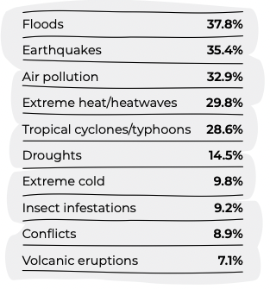
Most common disasters reported
In addition to the global COVID-19 pandemic the most common disasters people reported experiencing were:
94.2% of respondents had personally experienced a disaster in the previous three years.
96.3% of respondents believed themselves to be at risk of future disasters.

Slide 11
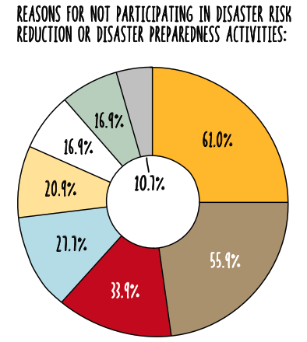
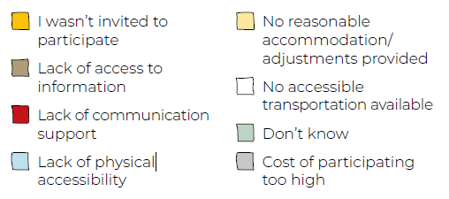
Participation in DRR activities
Less than half of all survey respondents (41.2%) had participated in DRR activities.
65.5% of people with disabilities reported that a lack of accessibility prevented them from being included in DRR activities.

Slide 12
Evacuation during a disaster
Barriers to seeking safety during disasters:
Difficulty moving to a safer location
Inaccessible and unsafe evacuation centres
Additional risks of gender-based violence for women and girls with disabilities
Discriminatory attitudes
More than 80% of respondents indicated that they would have difficulty evacuating to a safer location in the event of an emergency.

Slide 13
Speakers: 1. Professor Asha Hans - India 2. Jannatul Ferdous - Bangladesh 3. Rhema Masser – Tonga 4. Tekamagu Bwauira - Kiribati

Slide 14
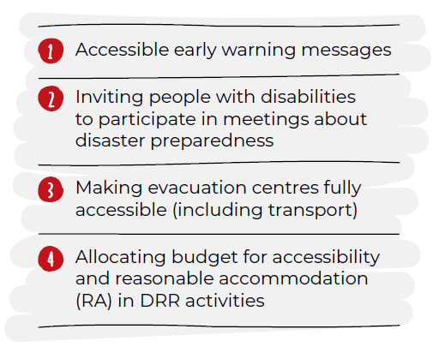
What is needed?
People with disabilities were asked what needs to be done for them to be safer in disasters. They said:

Slide 15
Questions and Where to from here?

Slide 16
ANIMATED VIDEO

Slide 17
Thank you!

